Slide 1
CSE 262: Programming Languages
Computer Science and Engineering
Lehigh University

Slide 2
Preface
These slides are not likely to be a suitable replacement for attendance and discussion.
Our intention is primarily to organize the lecture and to ensure proper coverage of the material.

Slide 3
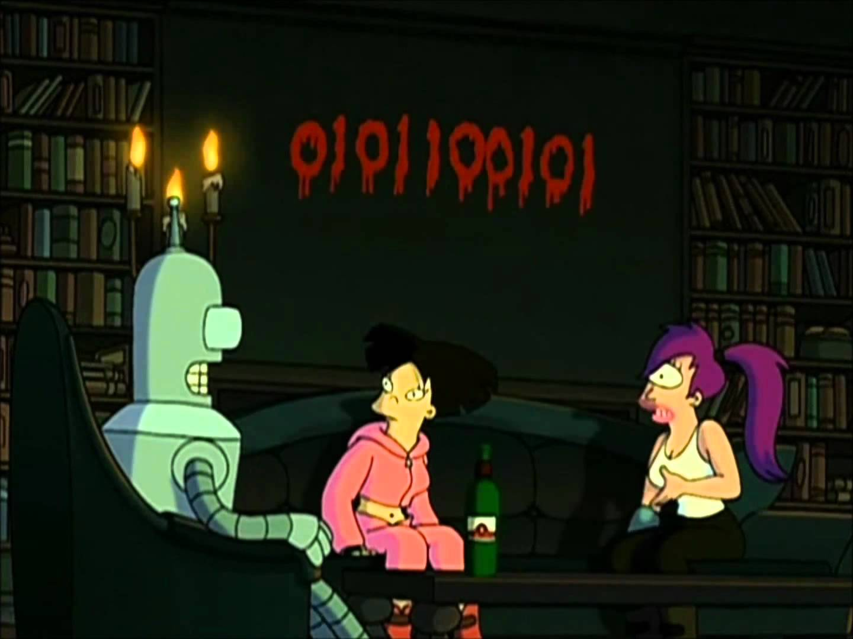
What is a programming language?
What is language?
What is programming?
How do the terms "language" and "programming" interact?
How do we use a programming language?

Slide 4
What is a programming language?
Alan Perlis refers to it as a "conceptual universe".
  Refer to his work, "Epigrams in Programming", for other Perlisisms and other amusing comments regarding problem solving, programming concepts, methodology.

Slide 5
Why are there so many programming languages?
Consider human languages?
Human behavior plays a role as well.
Application of the language
  Such as verbal vs written vs body.
https://www.levenez.com/lang/

Slide 6
Language Popularity
http://www.tiobe.com/tiobe-index/
http://blog.codeeval.com/codeevalblog/2016/2/2/most-popular-coding-languages-of-2016
http://www.codingdojo.com/blog/9-most-in-demand-programming-languages-of-2016/
http://pypl.github.io/PYPL.html
https://www.go-hero.net/jam/16/languages
http://codeforces.com/blog/entry/20525

Slide 7
What is a PL?
Syntax
Semantics
  Informal vs Formal
Names/Types
Paradigms

Slide 8
Our PL Paradigms
Imperative:
  C, Pascal
Object-Oriented:
  Java, C++, Smalltalk
Functional:
  LISP, ML, Haskell
Logic:
  Prolog, Monads in Haskell
Notes:
This list is by no means comprehensive.

Slide 9
Implementation
Syntax gives no meaning to the code, it only determines if it is valid.
The semantics determine the behavior and we can apply those through a transformation.

Slide 10
Transformations – Compiler
Source Program
Lexical Analyzer
Syntax Analyzer
Semantic Analyzer
Intermediate Code Generator
Code Optimizer
Code Generator
Target Program

Slide 11
Transformations - Interpreter
There are varying degrees of "Interpreting".
  Compare php, perl, python, java
Source Program
Input
Interpreter
Output
Source Program
Compiler
Input
Target Program
Output

Slide 12
Transformations
In general:
  Compilers are harder to implement and more efficient by translating code once into machine language.
  Interpreters are usually easier to implement but slower since they must translate source code every time.
    This behavior can be optimized.

Slide 13
Mixed-Mode
Java:
  Source code is compiled!
    Not to machine language though.
  The compiled code (java bytecode), is interpreted.
  Optimizations exist that reduce the amount of interpretation.

Slide 14
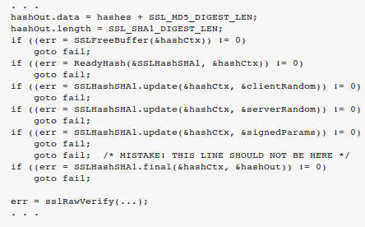
Language Design
Readability:
  Lots of time is spent debugging and maintaining code.
  Nuances: i++ vs ++i
Notes:
https://nakedsecurity.sophos.com/2014/02/24/anatomy-of-a-goto-fail-apples-ssl-bug-explained-plus-an-unofficial-patch/

Slide 15
Language Design
Simplicity:
  Mutually independent features
  Generic behavior:
    Python argument passing
Opinions on how "simple" a language should be?

Slide 16
Language Design
Efficiency:
  Caveat: Don't let current implementations condemn a language.
  Algol 68
  "real time" vs "Ada time"

Slide 17
Language Design
Safety and Reliability:
  Consistent program results.
  Ensuring correct manipulation of data:
    Type-safety
    Memory management

Slide 18
What is worthwhile?
Dominant languages and paradigms
  C/C++, Java – Imperative and OO Programming
Implementation issues
Performance challenges:
  Concurrency, correctness, event handling
Design trade-offs
Current context of Programming Language research in academia and industry.

Slide 19
We will start off talking a lot about underlying language behavior/design.
Some of this material can be very tricky.
It is ok not to understand everything, we all had to start somewhere.
I am generally very available to answer questions or help with the materials via office hours, unofficial office hours and email.
  Don't forget to utilize these resources!

Slide 20
The ACM Kickoff (first meeting equivalent?) is this Thursday (Sept 1st) at 4:10 in Packard 101.
The Lehigh vs Lafayette programming contest is Saturday, Sept 10th
  12-3pm in the Sunlab
I won't be here for office hours tomorrow (Thursday, Sept 1st). I'll be here from ~9am-11am though.
Take a look through the following page for some background into Backus-Naur Form:
  https://en.wikipedia.org/wiki/Backus%E2%80%93Naur_Form

